Slide 1
VIDEO GAMES SALES ANALYSIS
MADE BY : PARAG JYOTI NATH
SENT TO : JEN LI, LATIUM INC.

Slide 2
Project Overview
The dataset includes 64016 video game records, spanning from 1971 to 2024 providing valuable information on sales trends, console preferences, and regional differences.
The main objectives of this analysis are to:
1. Identify top-selling titles worldwide and analyze key success factors.
2. Examine sales trends over time to capture industry growth or decline.
3. Discover genre specializations across consoles.
4. Analyze regional popularity to spot localized preferences or disparities.

Slide 3
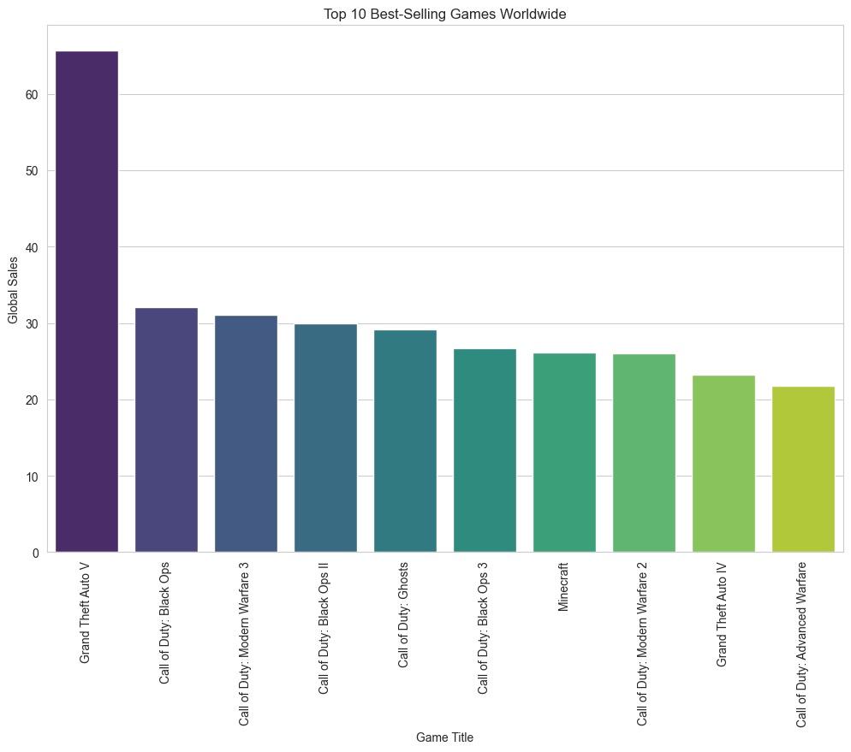
1.Top-Selling Games Worldwide

Slide 4
Insights
The top-selling game worldwide is Grand Theft Auto V (GTA 5)
Followed by Call of Duty: Black Ops and Call of Duty: Modern Warfare 3
Key success factors:
GTA 5 and Call of Duty, both are published by big names in the gaming industry such as Rockstar Games and Activision respectively.
Both of these games are part of a long standing series which were already hugely popular among the gamers. That popularity helped in the success of these recent titles.
GTA 5 belongs to the Role-Playing genre and Call of Duty belongs to the Shooter genre. Both of these genres are very popular among gamers as we will see ahead.

Slide 5
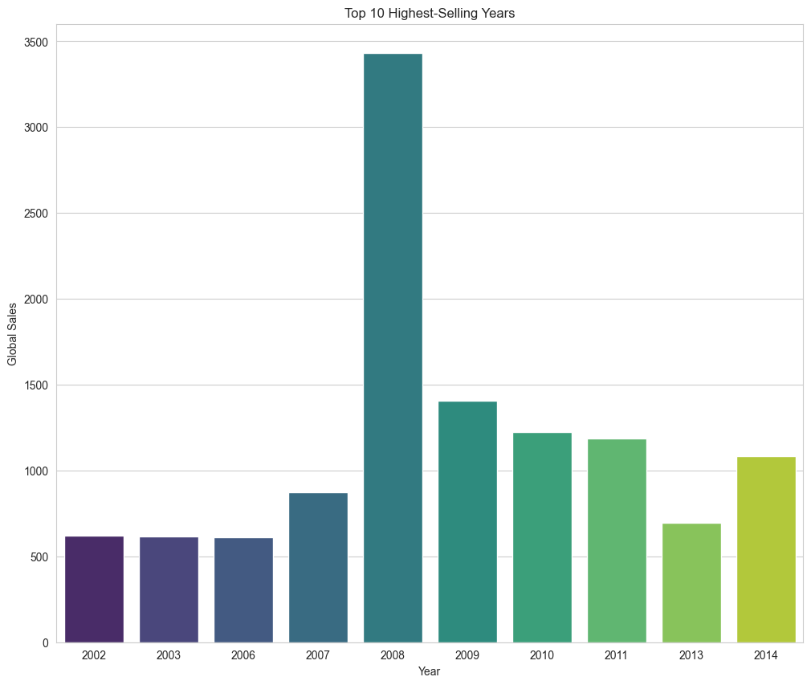
2.(a) Sale Trends (Highest Selling Years)

Slide 6
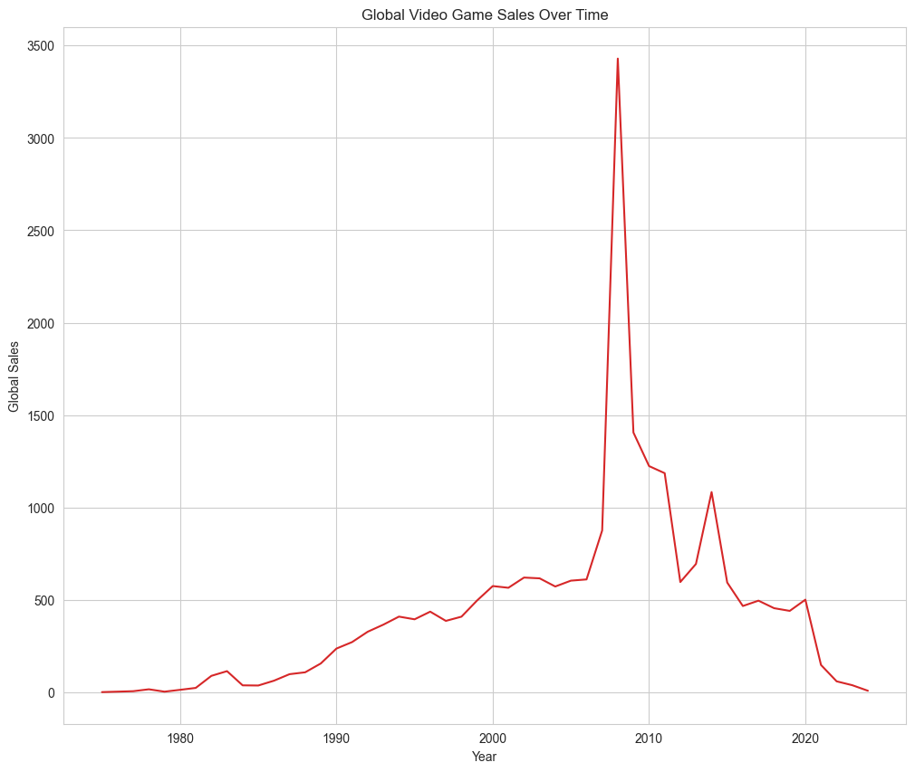
2.(b) Industry Growth Trend (1971 to 2024)

Slide 7
Insights
The top 10 highest-selling years in the gaming industry are 2002, 2003 and 2006 to 2014 in the period of 1971 to 2024.
2008 was the most successful year in the gaming industry ever.
Followed by 2009, 2010 and 2011.
Year 2008 showed a sharp jump in the sales. More than triple the amount of previous years.
But sales dropped down to less than half of 2008 next year.
However that still stayed nearly double of the sales before 2008.
Industry growth :
The gaming industry grew gradually up to 2008, and rose sharply in 2008. Then it declined gradually with variations in between.
Reasons for the 2008 growth spike:
The video game industry became a major part of the entertainment sector in 2008.
Unlike other parts of the tech industry, video games were not affected by the economic issues that were affecting the world in 2008.

Slide 8
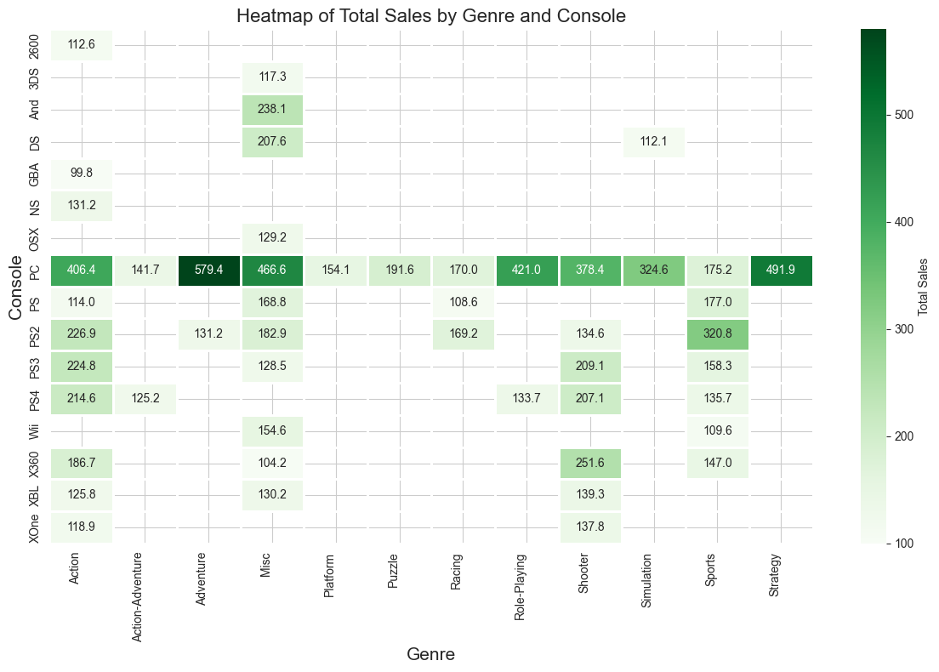
3. Genre preferences Across Consoles

Slide 9
Insights
Most popular console across all genres: PC
Genres like Action, Shooter and Sports have a widespread reach across multiple consoles. Rest of the genres are console specific. Misc. is just the collection of other less significant genres.
On PC, Adventure is the most popular genre, followed by Strategy, Role-Playing, Action, Shooter and Simulation, in that order.
Sports Genre on PS2 is also a considerably popular choice.
Strategy genre games are solely played on PC.
Action-Adventure and Role-Playing genres are only popular on PC and PS4 consoles.

Slide 10
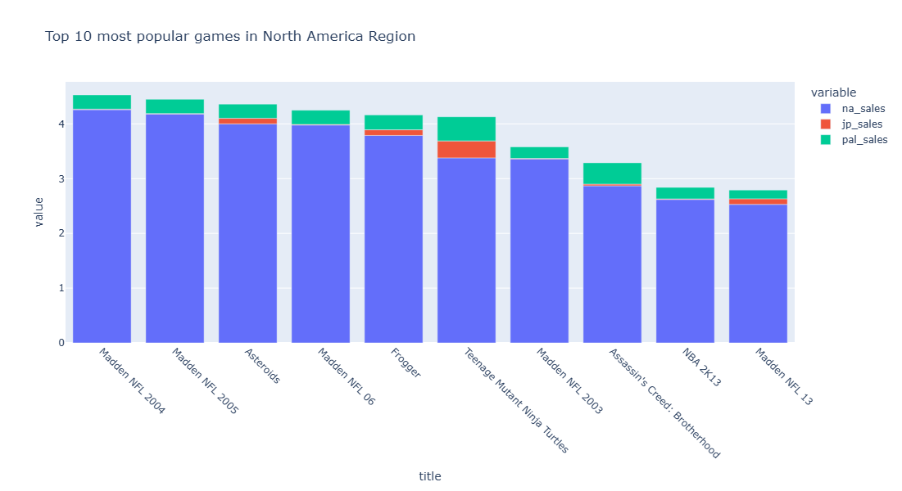
3.(a) Popularity of Games in North America

Slide 11
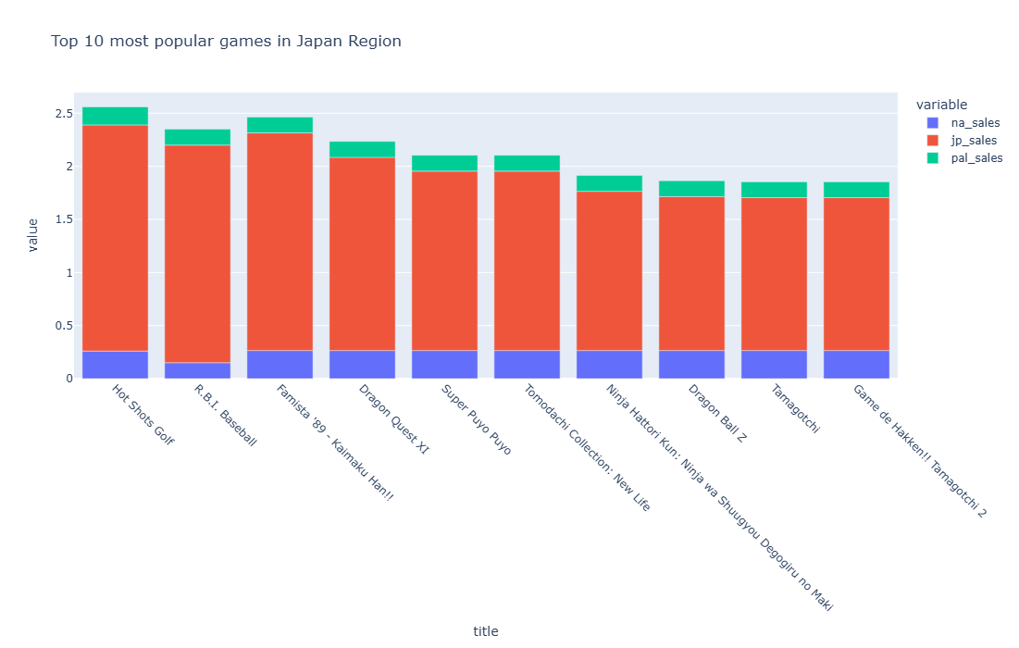
3.(b) Popularity of Games in Japan

Slide 12
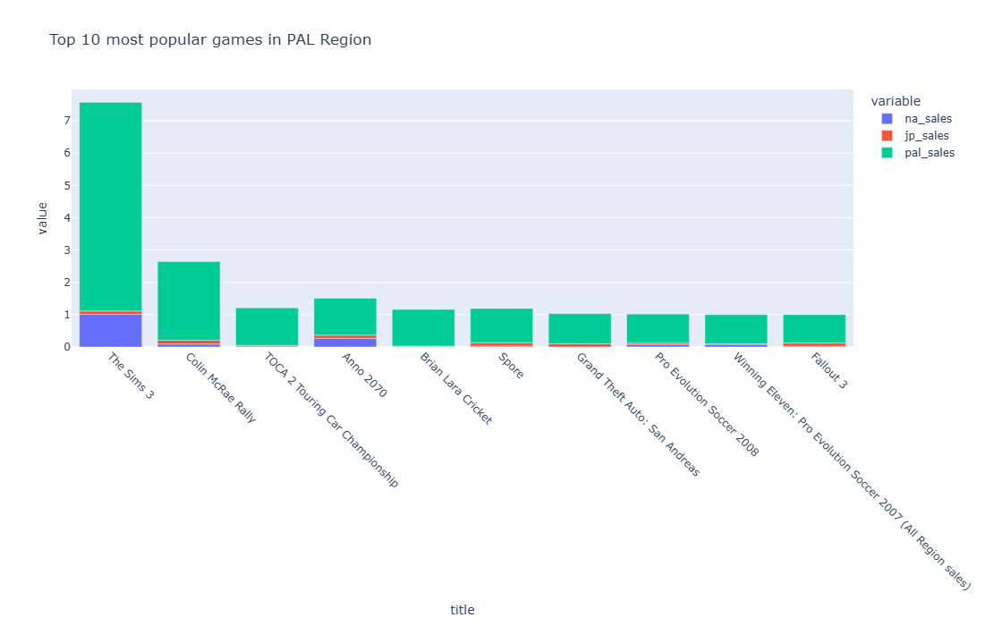
3.(c) Popularity of Games in PAL region

Slide 13
Notes
NA = North America region,
JP = Japan region,
PAL = Phase Alternation Region (includes most of Asia, Africa, Australia, New Zealand, and Europe)
Here regional popularity of a game is calculated based on it’s success in sales in one region and failure in sales in the other two regions.
If a game title has more than 80% of its total sales in one region and less than 20% of its total sales in the other two regions, then it is considered a region specific success.

Slide 14
Insights
North America:
Most popular games in North America are Madden NFL series, followed by Asteroids and Frogger.
This is due to Madden NFL being a game based on the sport American Football, which is only popular in USA (NA), but not in JP and PAL regions.
Japan:
Most popular games in Japan are Hot Shots Golf, RBI Baseball, Famista ’89.
Other popular games such as Ninja Hattori Kun and Dragon Ball Z are based upon Japanese TV shows. Hence the specific popularity in Japan only.
PAL Region:
The Sims 3 is the most popular game in PAL by a huge margin.
Other popular games like Colin Mcrae Rally, Touring Car Championship are games based upon rally racing, which is a popular sport in Europe.
Games like Pro Evolution Soccer series and Brian Lara Cricket are based upon football and cricket respectively, which are popular sports played in these countries.

Slide 15
THANK YOU

